Slide 1
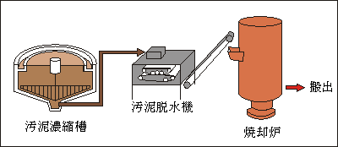
Exhaust gas 排ガス
Self-energy drying
NH3
（NH4）2SO4
Dewatered sludge
脱水汚泥
Air
空気
SO2
Bag Filter
バグフィルター
Composting &
Drying Device
堆肥化・乾燥装置
Heated Air 加熱空気
Heat exchanger熱交換器
Combustion furnace
燃焼炉
Dried sludge
乾燥汚泥
combustion gas
燃焼ガス
Sludge thickening
Carbonization furnace
炭化炉
Pyrolysis gas
熱分解ガス
Sludge dehydration system
BOD removal
Aeration tank
Chlorine blending basin
Carbide 炭化物
Settling basin
Discharge
Water
水
Sedimentation basin
Activated carbon liquid
活性炭液
Sewage treatment system (activated sludge treatment method)

